Slide 1


Macroeconomics is the study of the structure and performance of national economies and of the policies that governments use to try to affect economic performance.
inflationary trends in the country,
What determines a nation’s long-run economic growth?
What causes a nation’s economic activity to fluctuate?
What causes unemployment?
What causes prices to rise?
How does being a part of a global economic system affect nations’ economies?
Can government policies be used to improve economic performance?
  Rich nations have experienced extended periods of rapid economic growth.
  Poor nations either have never experienced them or economic growth was offset by economic decline.
Total output is increasing because of increasing population, i.e. the number of available workers.
Increasing average labour productivity: the amount of output produced per unit of labour input.
Rates of growth of output (or output per worker) are determined by:
  rates of saving and investment;
  rates of technological change;
  rates of change in other factors.

Slide 2

Business cycles are short-run contractions and expansions of economic activity.
Recession is the downward phase of a business cycle when national output is falling or growing slowly.
  Hard times for many people
  A major political concern
Recessions are usually accompanied by high unemployment: the number of people who are available for work and are actively seeking it but cannot find jobs.
The unemployment rate can stay high even when the economy is doing well.
When prices of most goods and services are rising over time it is inflation. When they are falling it is deflation.
The inflation rate is the percentage increase in the average level of prices.
When the inflation rate reaches an extremely high level the economy tends to function poorly. The purchasing power of money erodes quickly, which forces people to spend their money as soon as they receive it.

Slide 3
The International Economy
An economy which has extensive trading and financial relationships with other national economies is an open economy. An economy with no relationships is a closed economy.
International trade and borrowing relationships can transmit business cycles from country to country.
Exports and Imports
Indian exports are goods and services produced in India and consumed abroad.
Indian imports are goods and services produced abroad and consumed in India.
Trade Imbalances
Trade imbalances (trade surplus and deficit) affect output and employment.
  Trade surplus: exports exceed imports.
  Trade deficit: imports exceed exports.
The Exchange Rate
The trade balance is affected by the exchange rate:Rs vs. USD
Macroeconomic Policy
A nation’s economic performance depends on:
  natural and human resources;
  capital stock;
  technology
  economic choices made by citizens;
  macroeconomic policies of the government.

Slide 4
Aggregation
Macroeconomic policies:
  Fiscal policy: government spending and taxation at different government levels.
  Monetary policy: the central bank’s control of short-term interest rates and the money supply.
Budget Deficits
The economy is affected when there are large budget deficits: the excess of government spending over tax collection.
The large budget deficits of the 1980s and early 1990s are unusual.
  Borrowing from the public might divert funds from more productive uses.
  Federal budget deficits might be linked to the decline in productivity growth.
Macroeconomists ignore distinctions between individual product markets and focus on national totals.
The process of summing individual economic variables to obtain economywide totals is called aggregation.
What Macroeconomists Do
Macroeconomic forecasting
Macroeconomic analysis
Macroeconomic research
Data development

Slide 5
Macroeconomic Research
Macroeconomic Forecasting
Macroeconomic forecasting – prediction of future economic trends - has some success in the short run. In the long run too many factors are highly uncertain.
Macroeconomic Analysis
Macroeconomic analysis - analyzing and interpreting events as they happen – helps both private sector and public policymaking.
Macroeconomic research - trying to understand the structure of the economy in general – forms the basis for macroeconomic analysis and forecasting.
Economic Theory
Economic theory: a set of ideas about the economy to be organized in a logical framework.
Economic model: a simplified description of some aspects of the economy.
Developing and Testing a Theory
State the research question.
Make provisional assumptions.
Work out the implications of the theory.
Conduct an empirical analysis.
Evaluate the results.

Slide 6
Data Development
Macroeconomists use data to assess the state of the economy, make forecasts, analyze policy alternatives, and test theories.
Providers of data must:
  Decide what types of data should be collected based on who is expected to use the data and how.
  Ensure the measures of economic activity correspond to economic concepts.
  Guarantee the confidentiality of data.
Why Macroeconomists Disagree
A positive analysis examines the economic consequences of an economic policy, but it does not address its desirability.
A normative analysis tries to determine whether a certain economic policy should be used.
Economists can disagree on normative issues because of differences in values.
Economists disagree on positive issues because of different schools of thought.
The Classical Approach
The invisible hand of Economics: General welfare will be maximized (not the distribution of wealth) if:
  there are free markets;
  individuals act in their own best interest.
To maintain markets’ equilibrium – the quantities demanded and supplied are equal:
  Markets must function without impediments.
  Wages and prices should be flexible.
Thus, according to the classical approach, the government should have a limited role in the economy.

Slide 7
Evolution of the Classical-Keynesian Debate
The Keynesian Approach
Keynes (1936) assumed that wages and prices adjust slowly.
Thus, markets could be out of equilibrium for long periods of time and unemployment can persist.
Therefore, according to the Keynesian approach, governments can take actions to alleviate unemployment.
The government can purchase goods and services, thus increasing the demand for output and reducing unemployment.
Newly generated incomes would be spent and would raise employment even further.
After stagflation – high unemployment and high inflation – of the 1970s, a modernized classical approach reappeared.
Substantial communication and cross-pollination is taking place between the classical and the Keynesian approaches.
Unified Approach to Macroeconomics
Individuals, firms and the government interact in goods, asset and labour markets.
The macroeconomic analysis is based on the analysis of individual behaviour.
Keynesian and classical economists agree that in the long run prices and wages adjust to equilibrium levels.
The basic model will be used either with classical or Keynesian assumptions about flexibility of wages and prices in the short run.

Slide 8
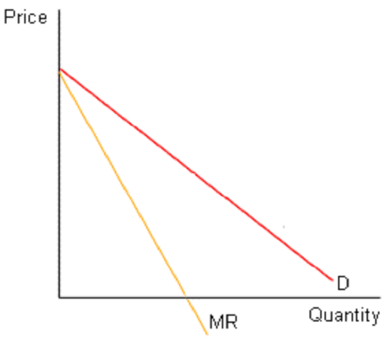
Monopolistic Competition
Characteristics of a monopolistically competitive market
Many buyers and sellers
Differentiated products
Easy entry and exit
Relationship to other market models
Monopolistic competition is similar to perfect competition in that:
  There are many buyers and sellers
  There are no barriers to entry or exit
Monopolistic competition is similar to monopoly in that:
  Each firm is the sole producer of a particular product (although there are close substitutes)
  The firm faces a downward sloping demand curve for its product
Demand curve facing a monopolistically competitive firm

Slide 9
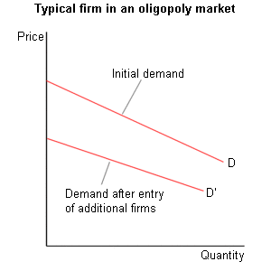
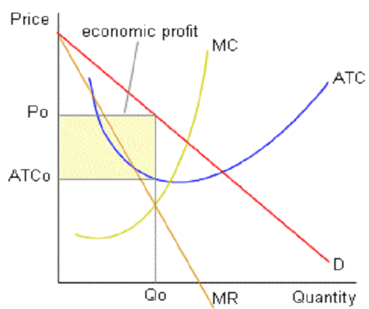
The firm’s demand curve and entry and exit
As firms enter a monopolistically competitive market, the demand facing a typical firm declines and becomes more elastic.
Short-run equilibrium in a monopolistically competitive industry
Economic profits lead to entry and a reduction in the demand facing a typical firm.

Slide 10
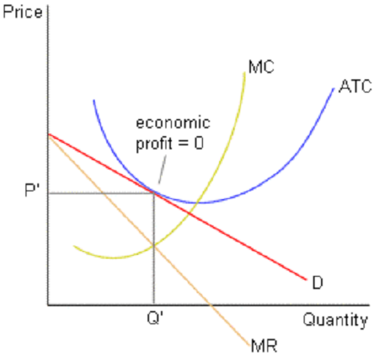
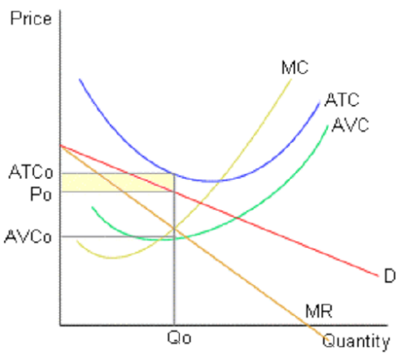
Long-run equilibrium in a monopolistically competitive industry
Entry continues until economic profit equals zero for a typical firm.
This equilibrium is often referred to as a “tangency equilibrium.”
Short-run equilibrium with economic losses

Slide 11
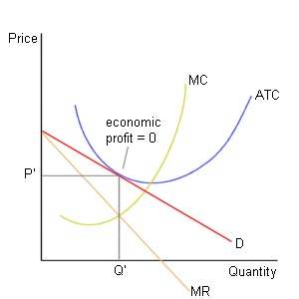
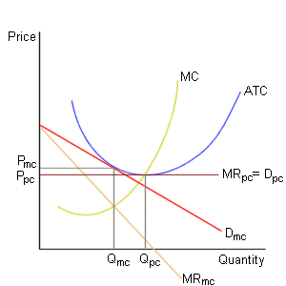
Long-run equilibrium
Monopolistic competition vs. perfect competition
A monopolistically competitive firm, in the long run, has “excess capacity” – (i.e., it produces a level of output that is below the least-cost level).
This is a cost of product variety.

Slide 12
Monopolistic competition and efficiency
As the number of firms rises, a monopolistically competitive firm’s demand curve becomes more elastic.
As the number of firms in a market expands, the market approaches a perfectly competitive market.
Thus, economic inefficiency may be smaller when there is a large number of firms in a monopolistically competitive market.
Product differentiation and advertising
Monopolistically competitive firms may receive short-run economic profit from successful product differentiation and advertising.
These profits are, however, expected to disappear in the long run as other firms copy successful innovations.
Location decisions
Monopolistically competitive firms often locate near each other to appeal to the “median” customer in a geographical region. (e.g., fast food restaurants and car dealerships)

Slide 13

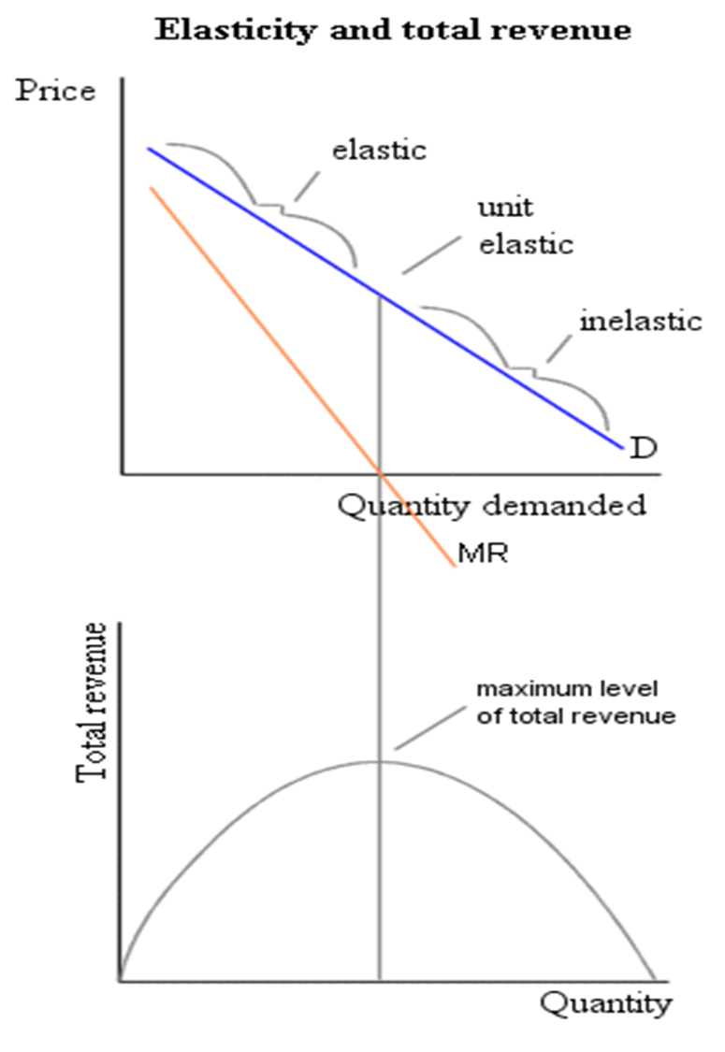
Monopoly market
single seller for a product with no close substitutes
barriers to entry
Barriers to entry
economies of scale
actions by firms
actions by government
Actions by firms to create and protect monopoly power
patents and copyrights,
high advertising expenditures result in high sunk costs (costs that are not recoverable on exit), and
illegal actions designed to restrict competition
Monopolies created by government action
patents and copyrights,
government created franchises, and
licensing.
Local monopoly
Local monopoly – a monopoly that exists in a local geographical area (e.g., local newspapers)
Price elasticity and MR
As noted earlier, since the demand curve facing a monopoly firms is downward sloping, MR < P
MR > 0 when demand is elastic
MR = 0 when demand is unit elastic
MR < 0 when demand is inelastic
Average revenue
As in all other market structures, AR=P (note that AR = TR/Q = (PxQ) / Q = P)
The price given by the demand curve is the average revenue that the firm receives at each level of output.

Slide 14
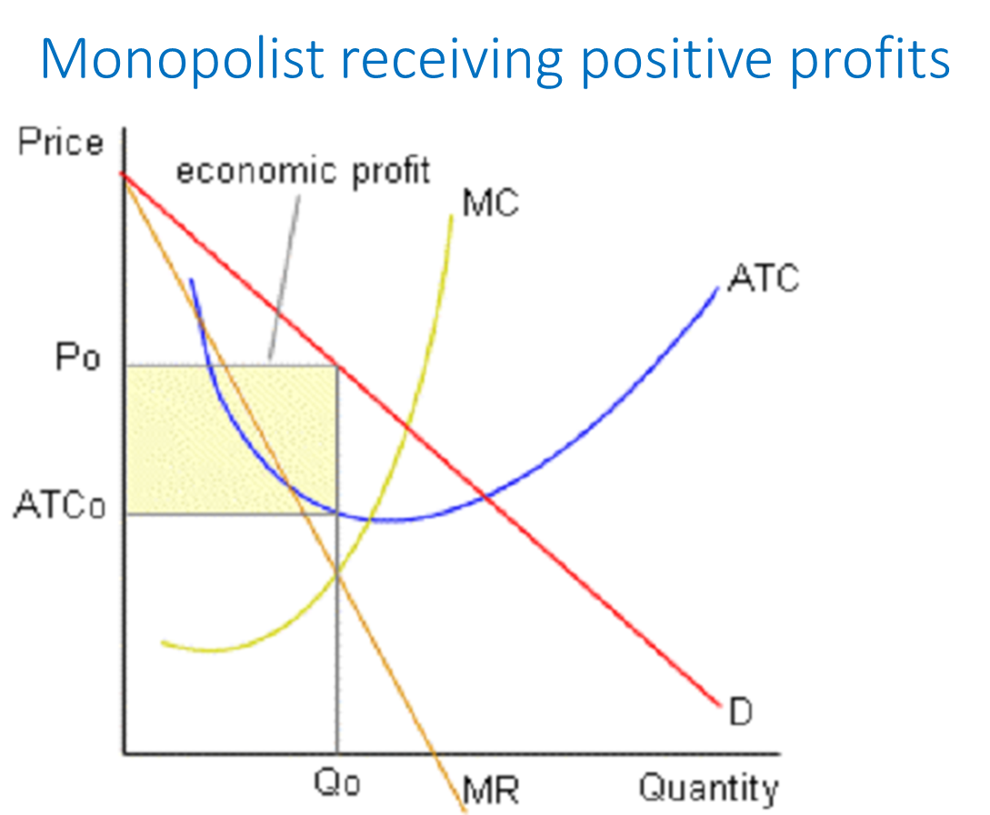
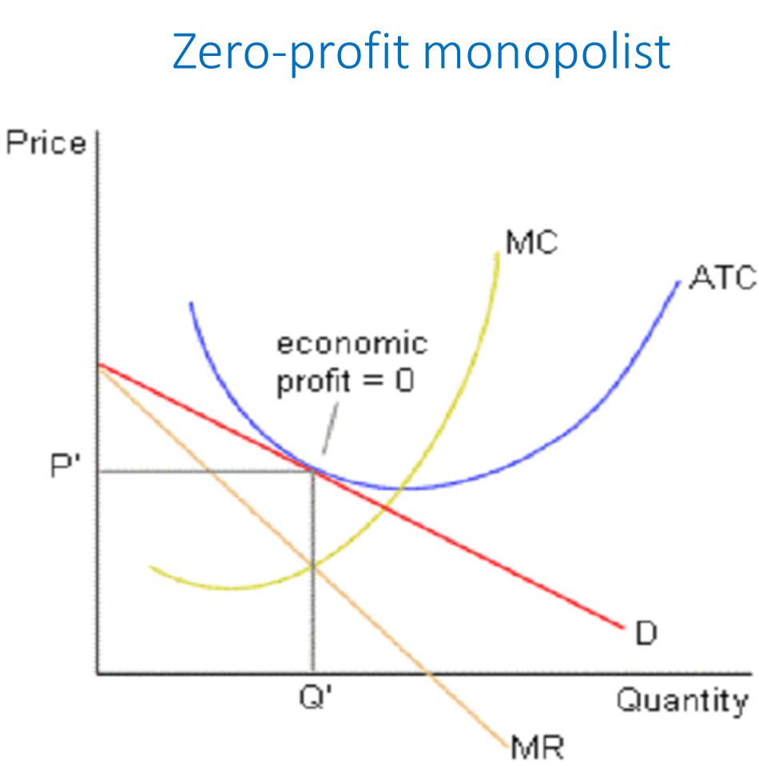
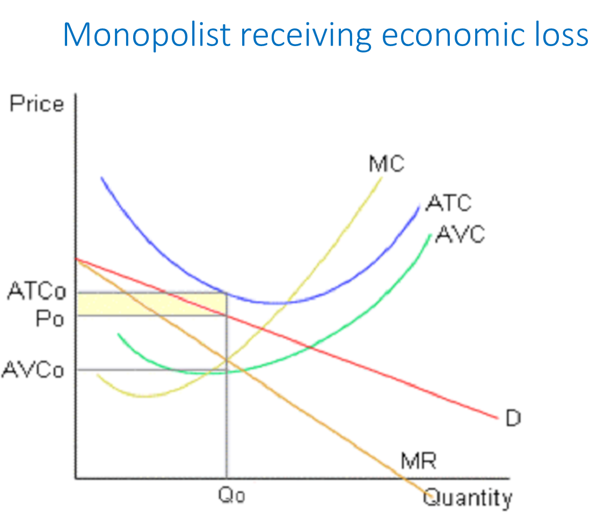
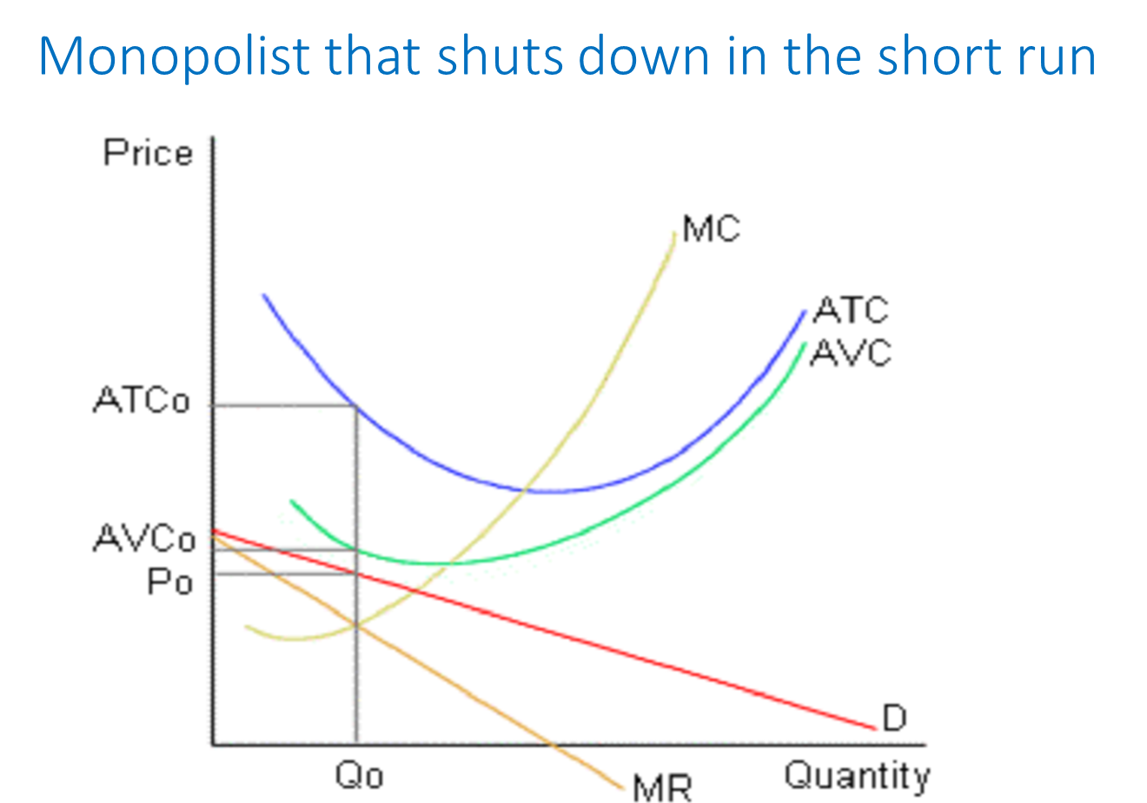
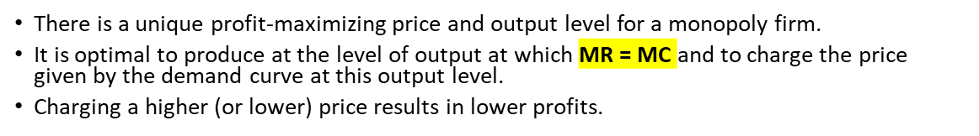
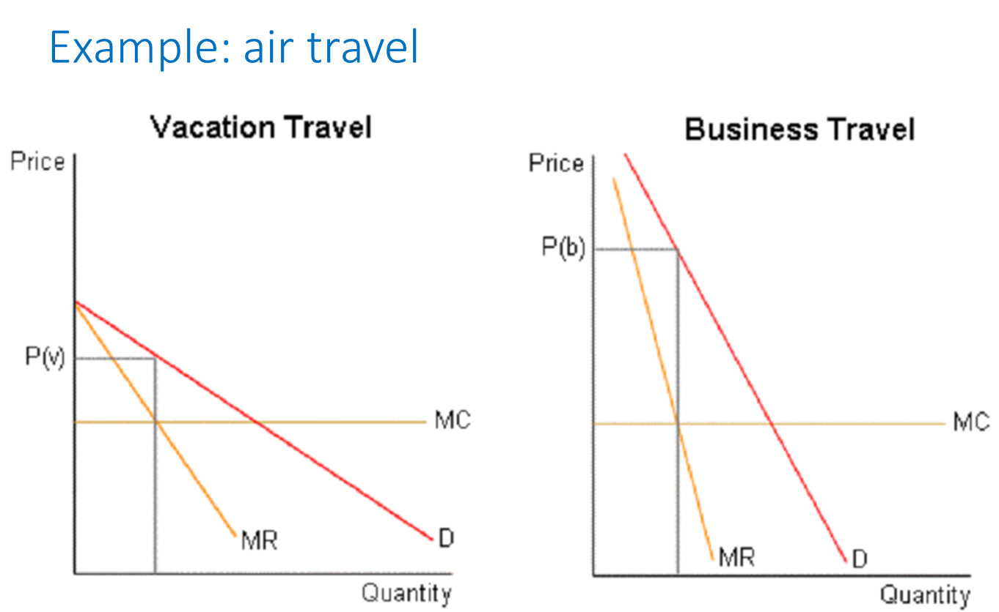
Monopoly price setting
Price discrimination
In imperfectly competitive markets, firms may increase their profits by engaging in price discrimination (charging higher prices to those customers with the most inelastic demand for the product).
Necessary conditions for price discrimination:
  the firm must not be a price-taker
  firms must be able to sort customers by their elasticity of demand
  resale must not be feasible
Other costs associated with monopoly
X-inefficiency –
occurs if firms do not have an incentive to engage in least-cost production (since they are not faced with competitive pressure).
Rent-seeking behavior –
the cost of using resources (such as lawyers, lobbyists, etc.) in an attempt to acquire monopoly power. This behavior does not benefit society and diverts resources away from productive activities.

Slide 15
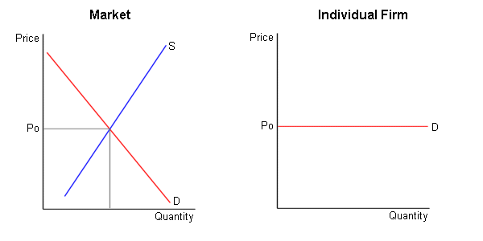
Perfect competition
Perfectly competitive market
many buyers and sellers,
identical (also known as homogeneous) products,
no barriers to either entry or exit, and
buyers and sellers have perfect information.
Demand curve facing a single firm
no individual firm can affect the market price
demand curve facing each firm is perfectly elastic

Slide 16

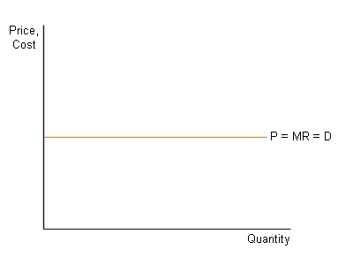
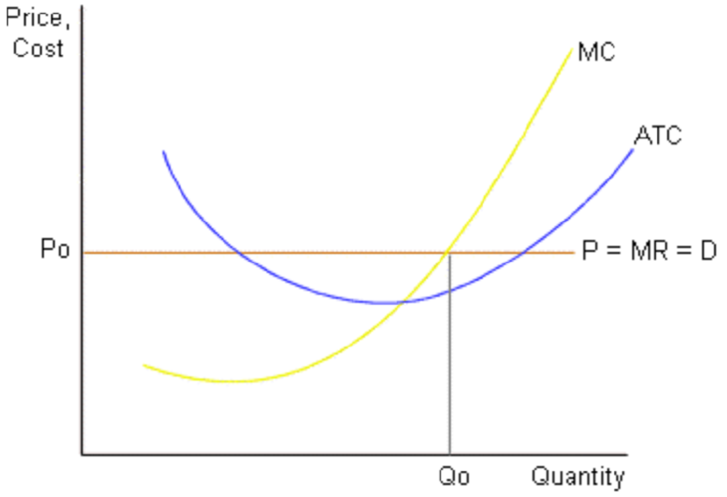
Profit maximization
produce where MR = MC
P = MR
Profit-maximizing level of output

Slide 17
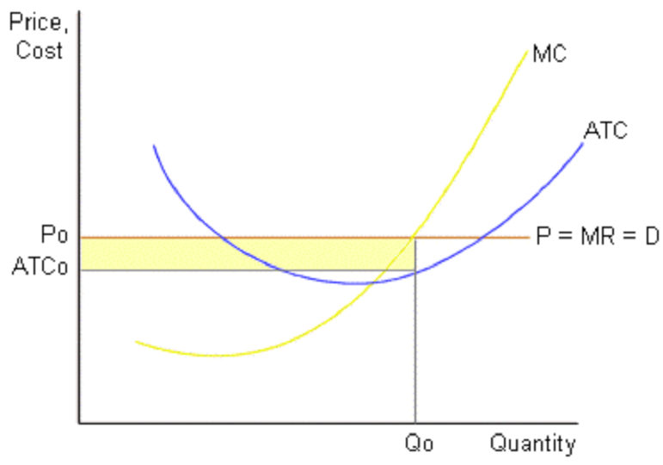
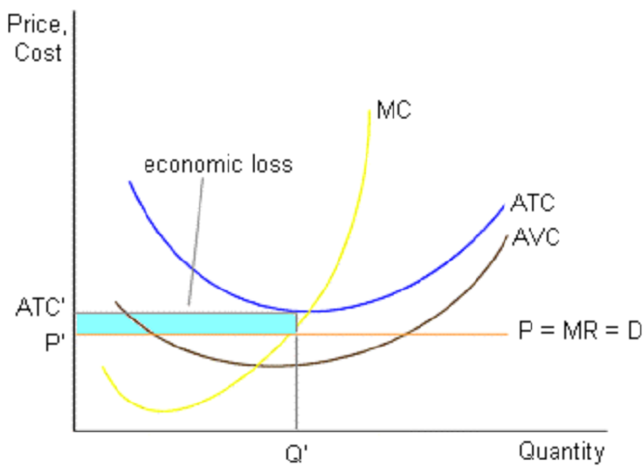
Economic Profits > 0
Loss minimization and the shut-down rule
Economic profit
Suppose that P < ATC. Since the firm is experiencing a loss, should it shut down?
Loss if shut down = fixed costs
Shut down in the short run only if the loss that occurs where MR = MC exceeds the loss that would occur if the firm shuts down (= fixed cost)
Stay in business if TR > VC. This implies that P > AVC. Shut down if P < AVC.
Economic loss (AVC<P< ATC)

Slide 18
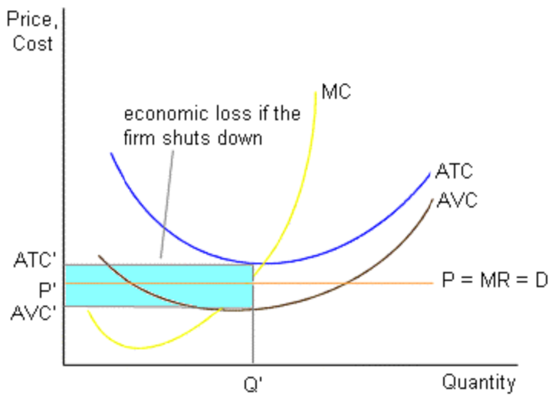
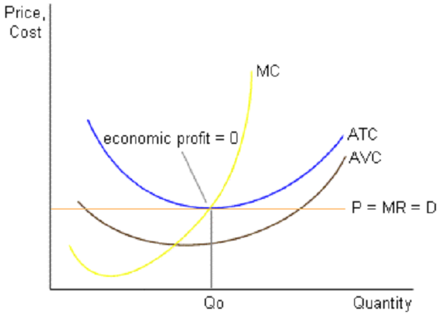
Break-even price
Loss if shut down
If price = minimum point on ATC curve, economic profit = 0.
Owners receive normal profit.
No incentive for firms to either enter or leave the market.

Slide 19
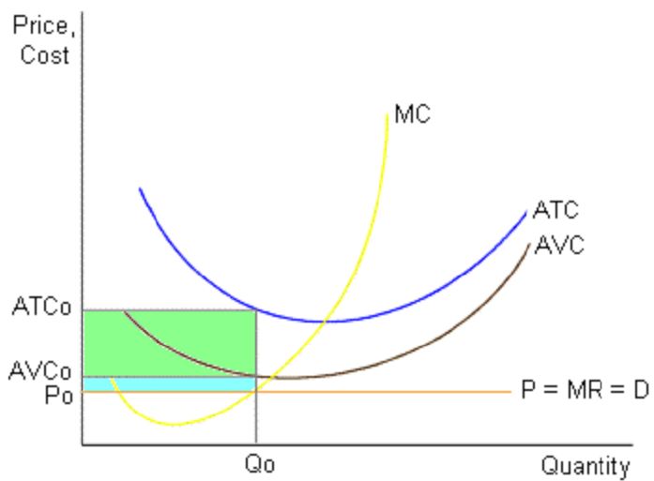
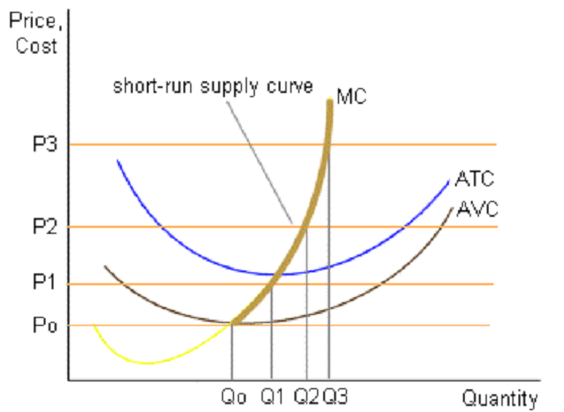
Short-run supply curve
P < AVC
A perfectly competitive firm will produce at the level of output at which P = MC, as long as P > AVC.

Slide 20
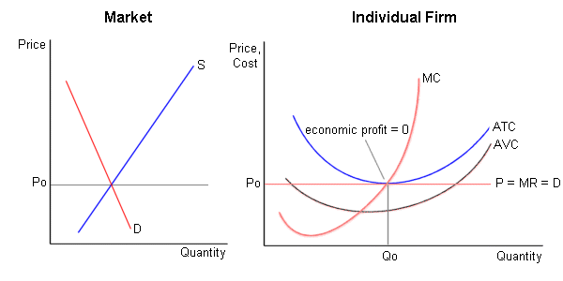
Long run
Firms enter if economic profits > 0
  market supply increases
  price declines
  profit declines until economic profit equals zero (and entry stops)
Firms exit if economic losses occur
  market supply decreases
  price rises
  losses decline until economic profit equals zero
Long-run equilibrium

Slide 21
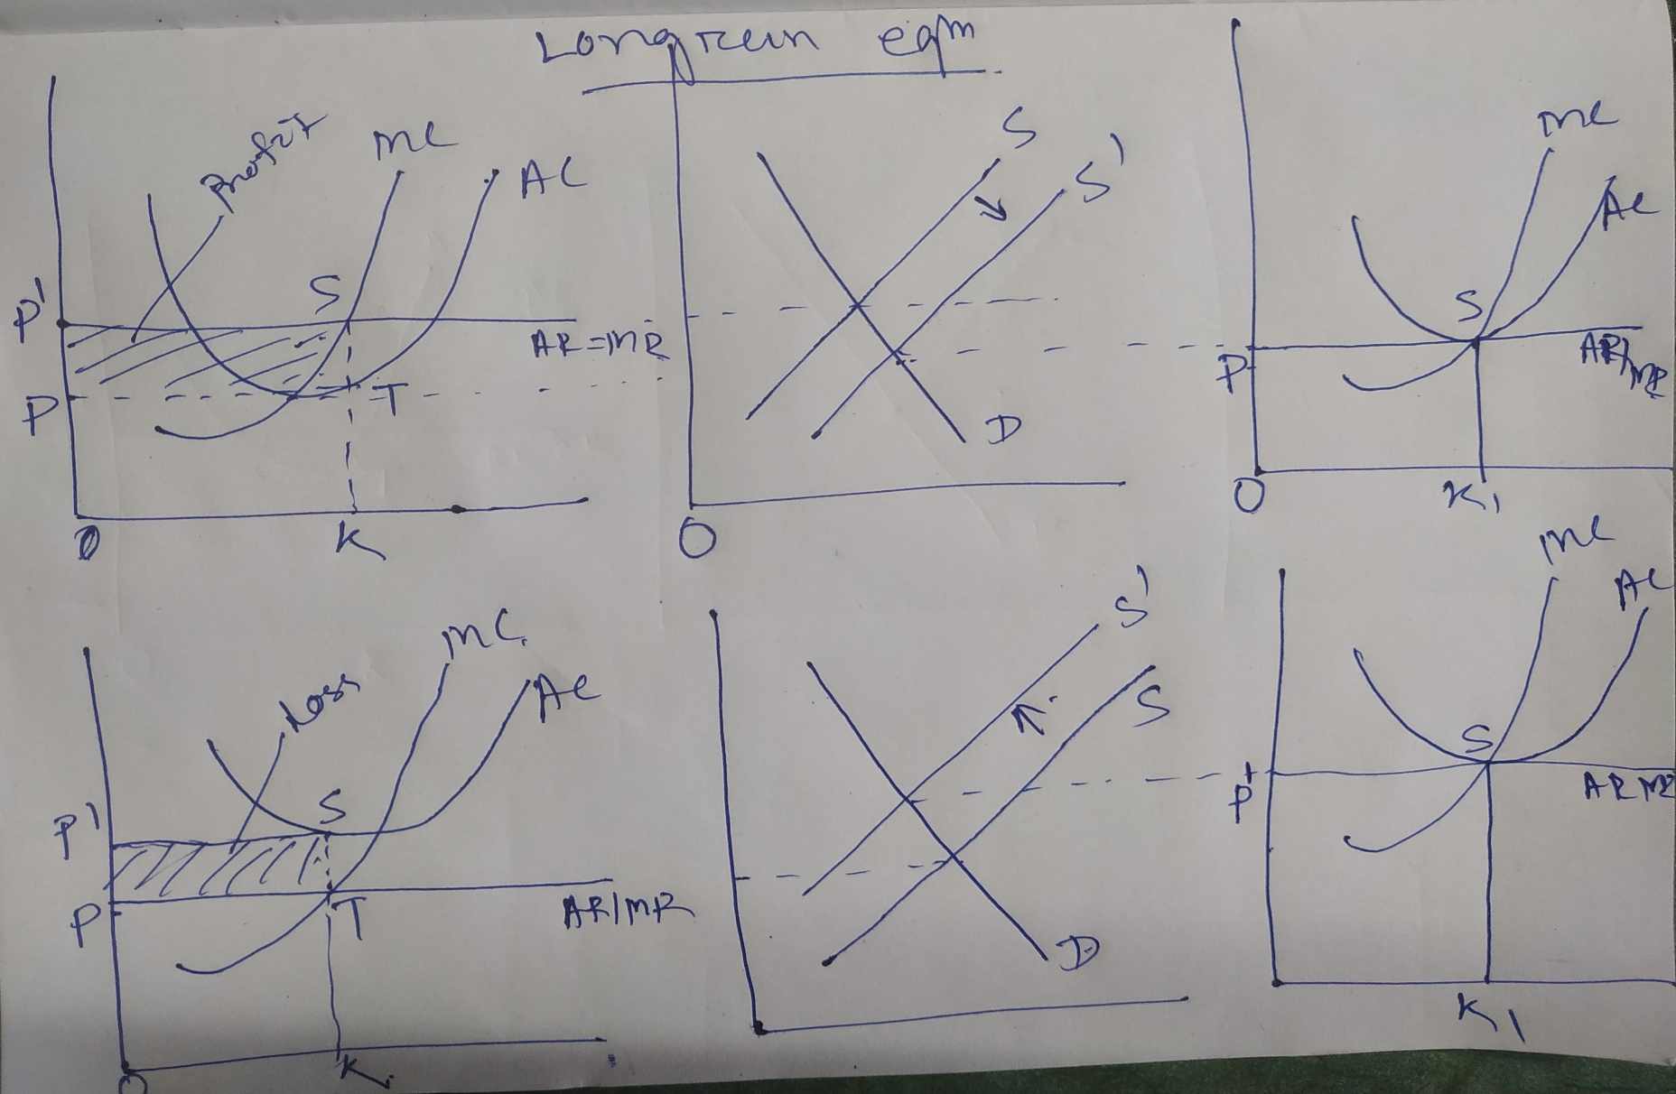
Long-run equilibrium and economic efficiency
Two desirable efficiency properties (assuming no market failure)
  P = MC (Social marginal benefit = social marginal cost)
  P = minimum ATC
Long-run equilibrium
Numerical problem
Cost function=q²+64q+1000
Demand function, q=(264-p)/9., where p=price, q=quanity
Find the profit maximizing output and price.

Slide 22


Gross Domestic Product (GDP)
Gross National Product (GNP)
Net National Product (NNP)
National Income (Net National Income at Factor Cost)
Personal Income
Personal Disposable Income
National Disposable Income
Private Income
GDP is the market value of all the final goods and services produced within a country for a given time period.
The following things must be kept in mind while calculating the GDP of a country
The word “domestic” in Gross Domestic Product pertains to the fact that only the goods and services produced within a country are counted in the GDP. For example – an Indian company – Haldiram produces potato chips and USA company PespiCo also produces potato chips in India. Since both these companies produce Chips within India – their product will be considered for calculation of GDP of India. Similarly – Tata motors producing Car in Gujarat is counted in India’s GDP. But, Tata motors producing Car in UK is not counted in India’s GDP
Only ‘final’ goods and services are included in the calculation of GDP. A final goods and services means goods and services meant for final consumption (for final user). It is unlike the intermediate goods and services which acts as component for final goods and services.
Goods and Services produced during a certain period (usually an year) is counted. In India, GDP is computed quarterly and yearly.
GNP is another measure for National Income of the country.
Indian economy is not closed economy but an open economy. India has transactions with the rest of the world in the form of exports, imports loans etc. This give rise to the concept of national or domestic Income.
In case of GDP, we calculate the market value of all the final goods and services produced within the country.
However, It may be the case that resident of India work and earn in some other foreign countries. Similarly, Conversely, some production taking place within a country may be attributed to temporary and seasonal foreign labour.
This is measured by the Gross National product.
It is measured as the GDP plus the Net Factor income from Abroad

Slide 23
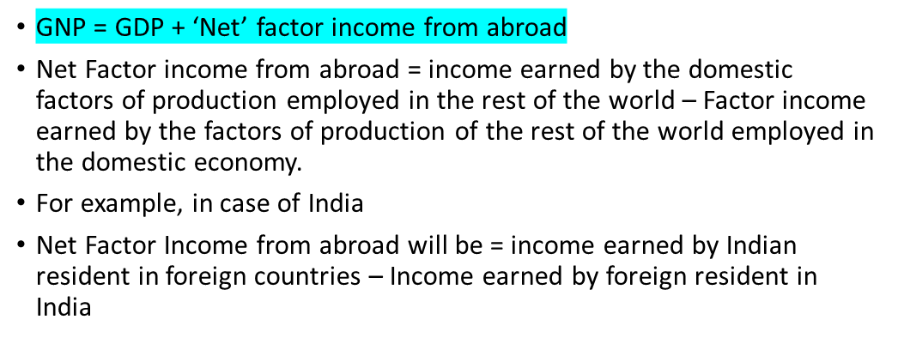

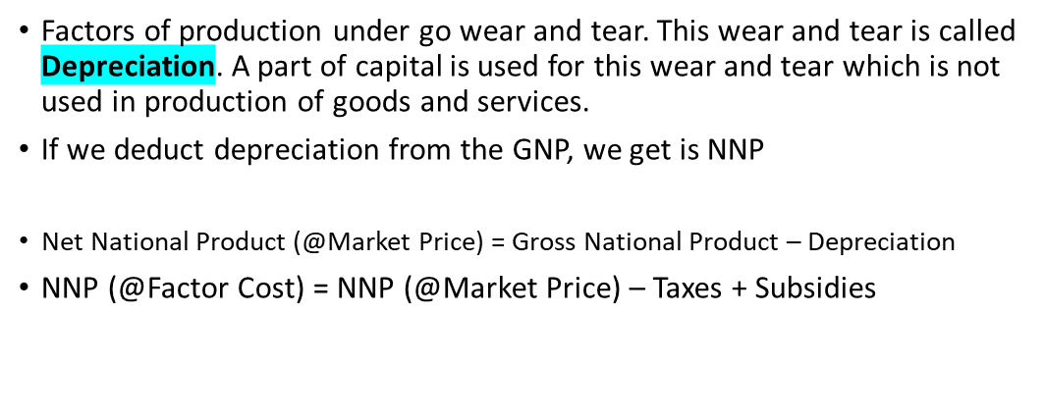

Personal Income is the part of National Income which is received by the households.
The formula for calculating Personal Income (PI) is
Personal income (PI) ≡ NI – Undistributed profits – Net interest payments made by households – Corporate tax + Transfer payments to the households from the government and firms.
Note
Undistributed profits – these are the profits which is not distributed to the households
Corporate Tax – It also does not accrue to the households

Slide 24



Personal Disposable Income refers to the income that is available to the households that they can spent as they wish.
All the Personal Income is not available to individuals to spend. They have to pay taxes (eg – Income tax) and non tax payment such as fines.
The formula for Personal Disposable Income is
Personal Disposable Income (PDI ) ≡ PI – Personal tax payments – Non-tax payments (such as fines etc)
National Disposable Income gives us an idea of what is the maximum amount of goods and services the domestic economy has at its disposal
The formula for National Disposable Income is
National Disposable Income = Net National Product at market prices + Other current transfers from the rest of the world
Note
Current transfers from the rest of the world includes items such as gifts, aids etc
Private Income = Factor income from net domestic product accruing to the private sector + National debt interest + Net factor income from abroad + Current transfers from government + Other net transfers from the rest of the world

Slide 25



According to Kindle Berger, "The balance of payments of a country is a systematic record of all economic transactions between the residents of the reporting country and residents of foreign countries during a given period of time".
It is a double entry system of record of all economic transactions between the residents of the country and the rest of the world carried out in a specific period of time.
when we say “a country’s balance of payments” we are referring to the transactions of its citizens and government.
It is a systematic record of all economic transactions between one country and the rest of the world.
It includes all transactions, visible as well as invisible.
It relates to a period of time. Generally, it is an annual statement.
It adopts a double-entry book-keeping system. It has two sides: credit side and debit side. Receipts are recorded on the credit side and payments on the debit side.
The difference between a country's imports and its exports. Balance
of trade is the largest component of a country's balance of
payments.
Debit items include imports, foreign aid, domestic spending abroad and domestic investments abroad.
Credit items include exports, foreign spending in the domestic economy and foreign investments in the domestic economy.
When exports are greater than imports than the BOT is favourable and if imports are greater than exports then it is unfavourable

Slide 26
Balance of Trade V/s Balance of Payment
It is a broad term.
It includes all transactions related to visible,
invisible and capital transfers.
It is always balances itself.
BOP = Current Account + Capital Account + or - Balancing item (Errors and omissions)
Following are main factors which affect BOP a)Conditions of foreign lenders. b)Economic policy of Govt. c) all the factors of BOT
It is a narrow term.
It includes only visible items.
It can be favourable or unfavourable.
BOT = Net Earning on Export - Net payment for imports.
Following are main factors which affect BOT
a) cost of production b) availability of raw materials c) Exchange rate d) Prices of goods manufactured at home
Current Account
Capital Account
Reserve Account
Errors & Omissions
BOP on current account is a statement of actual receipts and payments in short period.
It includes the value of export and imports of both visible and invisible goods. There can be either surplus or deficit in current account.
  The current account includes:- export & import of services, interests, profits, dividends and unilateral receipts/payments from/to abroad.
BOP on current account refers to the inclusion of three balances of namely – Merchandise balance, Services balance and Unilateral Transfer balance
The capital account records all international transactions that involve a resident of the country concerned changing either his assets with or his liabilities to a resident of another country. Transactions in the capital account reflect a change in a stock – either assets or liabilities.
It is difference between the receipts and payments on account of capital account. It refers to all financial transactions.
The capital account involves inflows and outflows relating to investments, short
term borrowings/lending, and medium term to long term borrowing/lending
LECTURE NOTES BY PARUL JAIN

Slide 27


Three accounts: IMF, SDR, & Reserve and Monetary Gold are collectively called as The Reserve Account.
The IMF account contains purchases (credits) and repurchase (debits) from International Monetary Fund.
Special Drawing Rights (SDRs) are a reserve asset created by IMF and allocated from time to time to member countries. It can be used to settle international payments between monetary authorities of two different countries.
The entries under this head relate mainly to leads and lags in reporting of transactions .
It is of a balancing entry and is needed to offset the overstated or understated components.
A disequilibrium in the balance of payment means its condition of Surplus Or deficit.
A Surplus in the BOP occurs when Total Receipts exceeds Total Payments.
Thus, BOP= CREDIT>DEBIT
A Deficit in the BOP occurs when Total Payments exceeds Total Receipts.
Thus, BOP= CREDIT<DEBIT
LECTURE NOTES BY PARUL JAIN
LECTURE NOTES BY PARUL JAIN
Causes of Disequilibrium In The BOP
Cyclical fluctuations
Short fall in the exports
Economic Development
Rapid increase in population
Structural Changes
Natural Calamites
International Capital Movements

Slide 28
Trends in Balance of Payment in India
BOP Position in the 50s
In the early 1950s when India launched its economic planning, the balance of payments position was more or less comfortable. India witnessed surplus in the current account and surplus in BOP position in the year 1952-53 and 1953-54. As a result India experienced an increase in the official reserves position.
During the second five year plan, trade deficit was much more than the net surplus on invisible transfers and surplus on capital account. India experienced an outflow from the official reserves account towards meeting the balance of payments requirements. The foreign exchange reserves of the country declined sharply during this period. The basic reason of the significant deficit in the BOP was that the country embarked upon the planned development in the fifties.
BOP Position in the 60s
During the decade of 60’s the balance on current account was unfavorable mainly because
of steep rise in imports of food grains, machinery and equipments and sluggish exports.
Heavy trade deficits, debt obligations and a sharp fall in foreign exchange reserves led to the devaluation of the rupee in 1966.
BOP Position in the 70s
In the early 70s, though exports grew more significantly, the larger increase in imports led to
continued trade deficits and India had deficits even in terms of invisible transfers.
In the year 1973-74, country faced pressure on the balance of payments as the import bill rose dramatically. As a result, India went for huge external assistance to tide over the balance of payment problems that become a regular feature thereafter.
BOP Position in the 80s
In the year 1979-80 India faced second oil shock that had a far more severe impact on the economy’s balance of payment than that of the first shock. Increase in oil prices substantially increased the import bill while exports failed to cope up with the rising imports. Export performance was depressed by the severe international recession of 1980-83.
Exports grew by about 3 percent, in terms of volume. As a result trade deficit widened during the entire decade of 1980 barring three years 1982-85.
However, during the latter half of 1980’s trade deficit reached new highs that put strains on BOP. The volume of imports rose sharper than the volume of exports.
During 1981-90, the current account deficit averaged 2.4 percent of GDP. The repayments to the I.M.F during the period put added pressure on the balance of payments.
LECTURE NOTES BY PARUL JAIN

Slide 29
BOP Position in the 90s
In the year 1991, India experienced the worst ever BOP crisis since independence. The year 1990-91 witnessed three major developments which contributed to this crisis-
  substantial increase in oil price following Gulf war that led to substantial increase in the import’s bill of the country. Further the remittances from Indian workers employed in Kuwait also stopped;
  decline in exports due to disintegration of USSR and
  problems on the domestic front (like fiscal imbalance, double digit inflation, political uncertainty
etc.).
2. By June 1991, the level of foreign exchange reserves dropped to the extent that they were barely sufficient to finance imports for a fortnight. The Government of India was on the verge of default on payment of external borrowings in June1991.
BOP Position in the 1992-95
1. During 1991 the economic reforms and macro-economic stabilization measures were
introduced to tide over the BOP crisis of 1991.
During 1993-94, the balance of payments position improves significantly due to growth in exports, fall in international prices of crude oil and the slack in the growth of non-oil imports. The trade deficit reduced dramatically.
During 1994-95, both exports and imports grew significantly: exports grew by 18.4 percent, in US dollar terms and imports by 22.9 percent. Invisible payments also rose considerably. As a result, the current account deficit widened.
BOP Position in the 1995-2007
In the year 1995-96 the surge in exports and imports continued. However the current account
deficit grew tremendously to 1.7 percent of GDP.
The balance of payments (BOP) has been in an overall surplus since 1996-97, with reserves rising .
India witnessed surplus in the current account for three consecutive years i.e. 2001-02, 2002- 03, and 2003-04. This surplus was accompanied by strong net capital inflows.
The current account recorded deficit since 2004-05 that is increasing. The deficit was caused by a burgeoning excess of merchandise imports over exports, which was left uncompensated by the net surplus in invisibles. The increase in imports occurs due to increase in the international price of crude and other major items of imports like gold.
The trade and current account deficit widened to 7.7 per cent and 1.5 percent of GDP in 2007-
08
LECTURE NOTES BY PARUL JAIN

Slide 30
Measures To Correct Disequilibrium in the BOP
Policy Measures :-
  Monetary Policy: The monetary policy is concerned with money supply and credit in the economy. The Central Bank may expand or contract the money supply in the economy through appropriate measures which will affect the prices.
  Fiscal Policy: Fiscal policy is government's policy on income and expenditure. Government incurs development and non - development expenditure,. It gets income through taxation and non - tax sources. Depending upon the situation governments expenditure may be increased or decreased.
c) Exchange Rate Depreciation: By reducing the value of the domestic currency, government can correct the disequilibrium in the BoP in the economy. Exchange rate depreciation reduces the value of home currency in relation to foreign currency. As a result, import
becomes costlier and export become cheaper. It also leads to
inflationary trends in the country,
d) Devaluation: devaluation is lowering the exchange value of the official currency. When a country devalues its currency, exports becomes cheaper and imports become expensive which causes a reduction in the BOP deficit.
Deflation: Deflation is the reduction in the quantity of money to reduce prices and incomes. In the domestic market, when the currency is deflated, there is a decrease in the income of the people. This puts curb on consumption and government can increase exports and earn more foreign exchange.
Exchange Control: All exporters are directed by the monetary authority to surrender their foreign exchange earnings, and the total available foreign exchange is rationed among the licensed importers. The license-holder can import any good but amount if fixed by monetary authority.
LECTURE NOTES BY PARUL JAIN

Slide 31
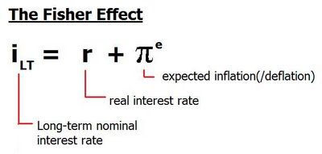
2. Non- Monetary measures :-
a) Export Promotion To control export promotions the country may adopt measures to stimulate
exports like:
export duties may be reduced to boost exports
cash assistance, subsidies can be given to exporters to increase exports
goods meant for exports can be exempted from all types of taxes.
b) Import Substitutes Steps may be taken to encourage the production of import substitutes. This will save foreign exchange in the short run by replacing the use of imports by these import substitutes.
Import Control :Import may be kept in check through the adoption of a wide variety of measures like quotas and tariffs. Under the quota system, the government fixes the maximum quantity of goods and services that can be imported during a particular time period.
  Quotas – Under the quota system, the government may fix and permit the maximum quantity or value of a commodity to be imported during a given period. By restricting imports through the quota system, the deficit is reduced and the balance of payments position is improved.
  Tariffs – Tariffs are duties (taxes) imposed on imports. When tariffs are imposed, the prices of imports would increase to the extent of tariff. The increased prices will reduced the demand for imported goods and at the same time induce domestic producers to produce more of import substitutes
LECTURE NOTES BY PARUL JAIN

Slide 32
International Trade
Absolute Cost Advantage Theory
Introduction
International trade is the exchange of capital, goods, and services across international borders or territories. international trade has existed throughout history, its economic, social, and political importance has been on the rise in recent centuries.
To understand the pattern in international trade, Different trade theories are postulated. Some famous trade theories are:
Absolute Advantage Theory
Comparative Advantage Theory
Hecksher-Ohlin Factor endowment theory
Absolute Advantage Theory
Origin of the theory
The main concept of absolute advantage is generally attributed to Adam Smith for his 1776 publication “An Inquiry into the Nature and Causes of the Wealth of Nations”, in which he countered mercantilist ideas.
Smith argued that it was impossible for all nations to become rich simultaneously by following mercantilism.
Because the export of one nation is another nation’s import and instead stated that all nations would gain simultaneously if they practiced free trade and specialized in accordance with their absolute advantage.
Smith also stated that the wealth of nations depends upon the goods and services available to their citizens, rather than their gold reserves.
While there are possible gains from trade with absolute advantage, the gains may not be mutually beneficial. Comparative advantage focuses on the range of possible mutually beneficial exchanges.

Slide 33

Drawbacks of Mercantilism Theory
Mercantilism weakens a country.
Restrictions on free trade decreases country’s wealth.
Overlooks other factors such as natural resources, manpower and its skill level, capital etc.
Restrictive Policies promoting exports and restrict imports creating trade barriers.
Colonial Exploitation.
Assumptions
Two Commodities are traded.
Trade is between two countries.
Assumes total world production and emphasis on efficiency.
No transportation cost between and within the country.
Factors are easily mobile within a country and immobile between the countries.
Full employment.
Free Trade exists between the countries.
The only element of cost of production is labour.
Adam Smith argued that a country has an absolute advantage in the production of a product when it is more efficient than any other country producing it.
Countries should specialize in the production of goods for which they have an absolute advantage and then trade these goods for the goods produced by other countries.
In economics, principle of absolute advantage refers to the ability of a party (an individual, or firm, or country) to produce more of a good or service than competitors, using the same amount of resources.
An Example:
 | US | UK
Wheat (bushels/hour) | 6 | 1
Cloth (yards/hour) | 4 | 5

Slide 34
Table shows that one hour of labour time produces 6 bushels of wheat in the US but only one in the UK. On the other hand, one hour of labour time produces 5 yards of cloth in the UK but only four in the US.
Thus the US is more efficient than, or has an absolute advantage over, the UK in the production of wheat, whereas the UK is more efficient than, or has an absolute advantage over, the US in the production of cloth.
With trade, the US would specialize in the production of wheat and exchange part of it for British cloth. The opposite is true for the UK. If the US exchanges six bushels of wheat (6W) for six yards of British cloth (6C), the United States gains 2C or saves 1/2 hour or 30 minutes of labour time.
Similarly, the 6W that the UK receives from the United States is equivalent to or would require six hours of labour time to produce in the United Kingdom. These same six hours can produce 30C in the UK(6 hours times 5 yards of cloth per hour).
By being able to exchange 6C for 6W with the US, the UK gains 24C, or saves almost five labour - hours.
The fact that the United Kingdom gains much more than the United States is not important at this time. What is important is that both nations can gain from specialization in production and trade.
This theory is based upon principle of division of labour.
Free Trade among countries can increase a country’s wealth.
Free Trade enables a country to provide a variety of goods and services to its people by specializing in the production of some goods and services and importing others.
Every country should specialize in producing those products at cost less than that of other countries and exchange these products with other products produced cheaply by others.
When one country produces a product at a lower cost and another country produces another product at a lower cost, both can exchange required quantity and can enjoy benefits of absolute cost advantage.

Slide 35
Conclusion
Advantages of this Theory:
Specialization : Specialization of labour leads to higher productivity and allows to achieve less labour cost per unit of output.
Suitability : Suitability of the skills of labour of the country in producing certain products
Economies of scale: Economies of Scale helps to reduce Scale the labour cost per unit of output
Significance of this Theory:
More quantity of both products
Increased standard of living for both countries
Increased production efficiency
Increase in global efficiency and effectiveness
Maximization of global productivity and other resources productivity.
Limitations
No absolute advantages for many countries
Country size varies
Country by country differences in specializations
Deals with labour only and neglects other factors of production
Neglected Transport cost
Theory is based on an assumption that Exchange rates are stable and fixed.
It also assumes that labour can switch between products easily and they will work with same efficiency which in reality cannot happen.
Absolute advantage, however, can explain only a very small part of world trade today, such as some of the trade between developed and developing countries.
Most of world trade, especially trade among developed countries, could not be explained by absolute advantage.
It remained for David Ricardo, with the law of comparative advantage, to truly explain the basis for and the gains from trade.
Indeed, absolute advantage will be seen to be only a special case of the more general theory of comparative advantage.

Slide 36
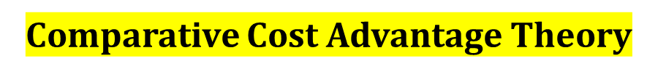
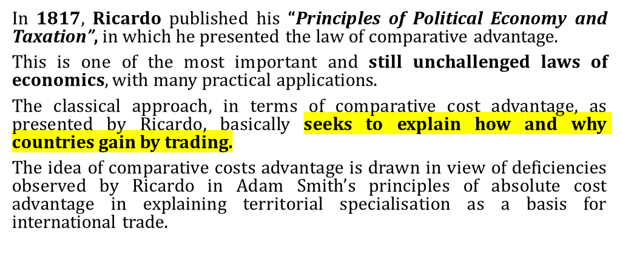

Being dissatisfied with the application of classical labour theory of value in the case of foreign trade, Ricardo developed a theory of comparative cost advantage to explain the basis of international trade as under:
According to the law of comparative advantage, even if one nation is less efficient than (has an absolute disadvantage with respect to) the other nation in the production of both commodities, there is still a basis for mutually beneficial trade.
The first nation should specialize in the production and export of the commodity in which its absolute disadvantage is smaller (this is the commodity of its comparative advantage) and import the commodity in which its absolute disadvantage is greater (this is the commodity of its comparative disadvantage).

Slide 37
The Ricardian Model
To explain his theory of comparative cost advantage, Ricardo constructed a two-country, two-commodity, but one-factor model with the following assumptions:
Labour is the only productive factor.
Costs of production are measured in terms of the labour units involved.
Labour is perfectly mobile within a country but immobile internationally.
Labour is homogeneous.
There is unrestricted or free trade.
There are constant returns to scale.
There is full employment equilibrium.
There is perfect competition both in factor and product market.
Only two commodities to be exchanged between the two countries.
No government intervention.
Ricardian Theorem
The statement of the law can be clarified by looking at this table. The only difference between this table and previous table (which was illustrated in absolute cost advantage theory) is that the U.K now produces only two yards of cloth per hour instead of five.
Thus, the U.K now has an absolute disadvantage in the production of both wheat and cloth with respect to the United States.
However, since U.K. labour is half as productive in cloth but six times less productive in wheat with respect to the United States, the U.K has a comparative advantage in cloth.
On the other hand, the United States has an absolute advantage in both wheat and cloth with respect to the U.K, but since its absolute advantage is greater in wheat (6:1) than in cloth (4:2), the United States has a comparative advantage in wheat.
 | US | UK
Wheat (bushels/hour) | 6 | 3
Cloth (yards/hour) | 4 | 2

Slide 38
Gain Attributes of International Trade
To summarize, the U.S. absolute advantage is greater in wheat, so its comparative advantage lies in wheat.
The U.K’s absolute disadvantage is smaller in cloth, so its comparative advantage lies in cloth.
According to the law of comparative advantage, both nations can gain if the United States specializes in the production of wheat and exports some of it in exchange for British cloth. (At the same time, the U.K is specializing in the production and exporting of cloth.)
Note that in a two-nation, two-commodity world, once it is determined that one nation has a comparative advantage in one commodity, then the other nation must necessarily have a comparative advantage in the other commodity.
In a two-nation, two-commodity world, once it is determined that one nation has a comparative advantage in one commodity, then the other nation must necessarily have a comparative advantage in the other commodity.
In fact, the principle of comparative costs shows that it is possible for both the countries to gain from trade, even if one of them is more efficient than the other in all lines of production.
The theory implies that comparative costs are different in different countries because the abundance of factors which may be necessary for the production of each commodity does not bear the same relation to the demand for each commodity in different countries.
Thus, specialisation based on comparative cost advantage clearly represents a gain to the trading countries in so far as it enables more of each variety of goods to be produced cheaply by utilising the abundant factors fully in the country concerned and to obtain relatively cheaper goods through mutual international exchange.
Ricardo’s theory pleads the case for free trade. He stresses that free-trade is the pre-requisite of gains and improvement of world’s welfare. Free trade “by increasing the general mass of production diffuses general benefit and binds together by one common tie of interest and intercourse, the universal society of nations throughout the civilised world.”

Slide 39
Case of No Comparative Advantage
To sum up, what goods will be exchanged in international trade is the main question solved by Ricardo’s theory of comparative costs. The theory is lucidly summarised by Kindle-Berger as follows:
“The basis for trade, so far as supply is concerned, is found in differences in comparative costs. One country may be more efficient than another, as measured by factor inputs per unit of output, in the production of every possible commodity, but so long as it is not equally more efficient in every commodity, a basis for trade exists. It will pay the country to produce more of those goods in which it is relatively more efficient and to export these in return for goods in which its absolute advantage is least.
This occurs when the absolute disadvantage that one nation has with respect to another nation is the same in both commodities.
For example, if one hour produced 3W instead of 1W in the U.K(see above Table), the U.K would be exactly half as productive as the United States in both wheat and cloth. The U.K (and the US) would then have a comparative advantage in neither commodity, and no mutually beneficial trade could take place.
The reason for this is that (as earlier) the US will trade only if it can exchange 6W for more than 4C. However, now the U.K is not willing to give up more than 4C to obtain 6W from the US because the U.K can produce either 6W or 4C with two hours domestically. Under these circumstances, no mutually beneficial trade can take place.
This requires slightly modifying the statement of the law of comparative advantage to read as follows: Even if one nation has an absolute disadvantage with respect to the other nation in the production of both commodities, there is still a basis for mutually beneficial trade, unless the absolute disadvantage (that one nation has with respect to the other nation) is in the same proportion for the two commodities.

Slide 40
Terms of Trade
Terms of trade The ratio at which a country can trade domestic products for imported products.
Exchange rates: The ratio at which two currencies are traded. The price of one currency in terms of another.
Trade Barriers: Tariffs, export Subsidies,
and Quotas
Trade barriers—also called obstacles to trade—take many forms. The three most common are tariffs, export subsidies, and quotas. All are forms of protection shielding some sector of the economy from foreign competition.
protection The practice of shielding a sector of the economy from foreign competition.
tariff A tax on imports.
export subsidies Government payments made to domestic firms to encourage exports.

